Slide 1
MELBOURNE
HOUSING PRICES
Predicting Housing Prices in Melbourne, Australia
Presented by Usman Shaikh

Slide 2
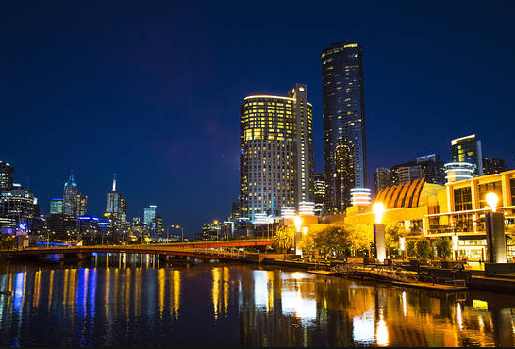
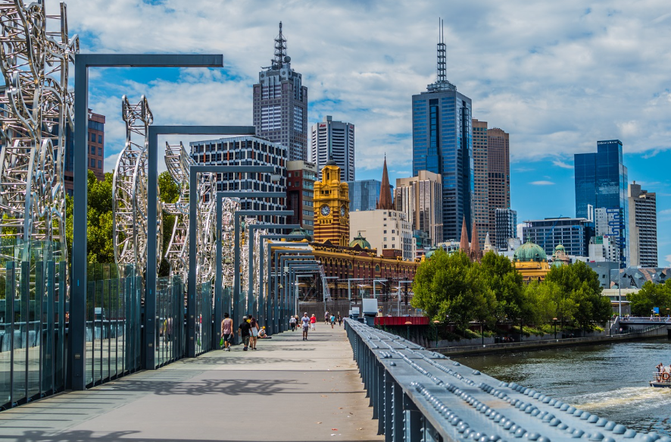

Dataset: Melbourne housing clearance data from Jan 2016
Source: https://www.kaggle.com/anthonypino/melbourne-housing-market

Slide 3
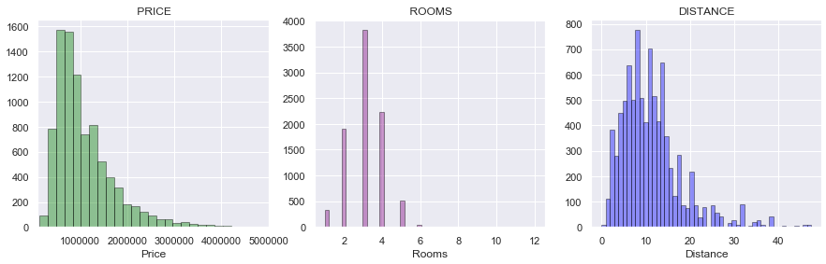
Exploratory Analysis: Understanding the Dataset – I
Mean : 1,092, 902
Mode : 3
Mean : 11.19
Bulk of the housing prices in Melbourne Australia fall between 0 to 1.5 Million Dollars with a mean value of $1,092,902.
Most places have 3 rooms and are located at a mean distance of 11.19 Kilometers from the Central Business District.
Most properties are located with in a range of 18 Kilometers from Central Business District (CBD).

Slide 4
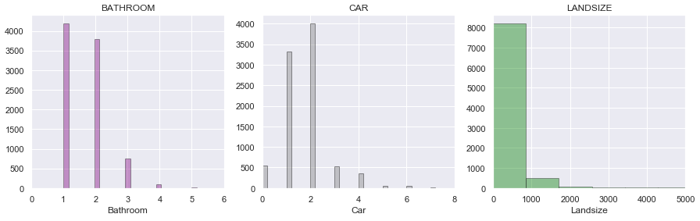
Exploratory Analysis: Understanding the Dataset – II
Mode : 1
Mode : 2
Mean : 523.48
The common number of Bathrooms per property appears to be 1 followed by 2 car spaces.
The Land size of most properties fall between 0 to 2,500 Square Meters, with over 90% of the values falling under 1,000 Square Meters.

Slide 5
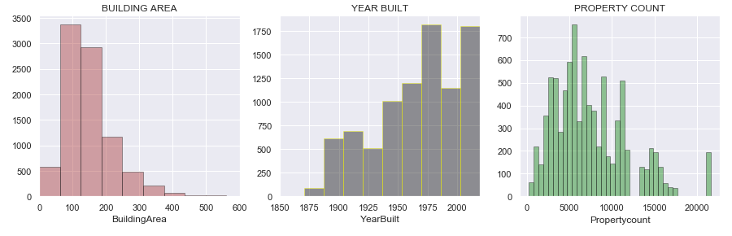
Exploratory Analysis: Understanding the Dataset – III
Mean : 149.30
Mean : 1965
Mean : 7475.94
The building area for most of the properties fall between 50 and 200 Square Meters with a mean value of 149.30
The housing construction shows a gradual rising trend over the years with a mean value year of 1965.
The housing market witnessed increased amount of construction in mid seventy’s , late 90’s followed by 2000’s.

Slide 6
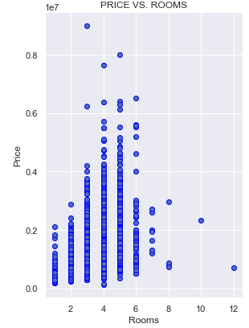
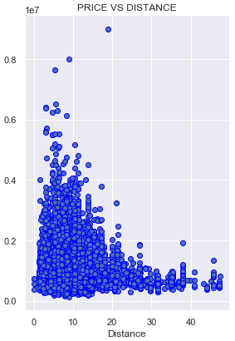
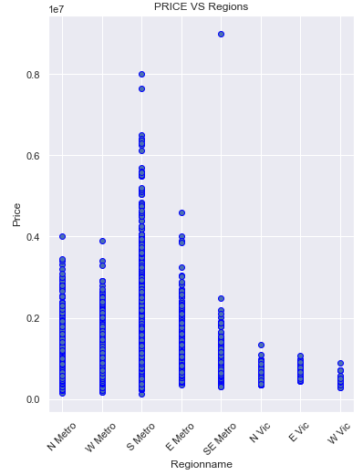
Relationship between Price and other Factors – I
The housing prices appear to increase with the number of rooms but starts to fall after 5 rooms
Likewise the price appears to rise with fall in distance with highest values for properties located in a 5 to 6 Km radius from CBD.
Region wise South Metro is closest to the Central Business District and appears to be most expensive followed by East Metro.

Slide 7
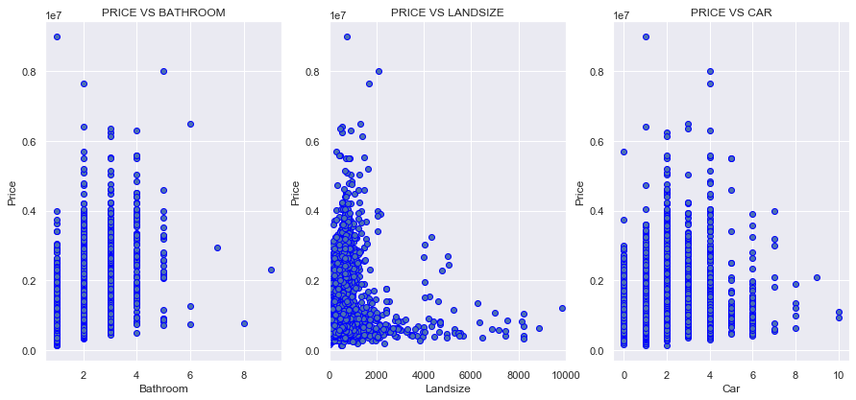
Relationship between Price and other Factors – II
The housing prices appear to increase with the number of Bathrooms however price starts to fall after a number of 3 Bathrooms.
Majority of the land size falls under 1500 Square Meters and the price is highest around 1000 Square Meters.
The price is highest for 4 car spaces however it starts to fall once it reaches four car spaces

Slide 8
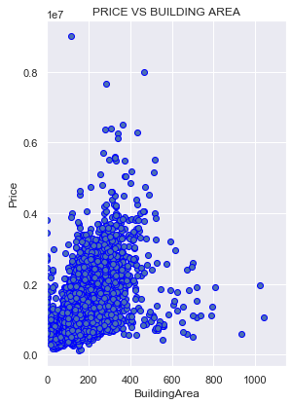
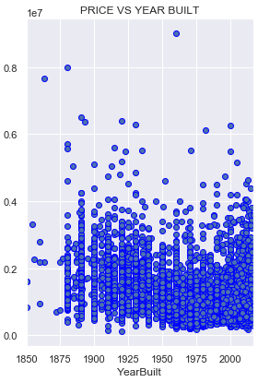
Relationship between Price and other Factors - III
There appears to be a correlation between Price and Building Area, 0.51 to be precise on a scale of -1 to 1
The priciest properties seem to be built in early 1900’s, late 90’s and 2000’s , as population in those years appear more dense.
Price analysis show that homes with 3 bedrooms, 2 bathrooms, 2 car spaces, land size of 1000 Sqm, building area of 300 Sqm built in early 1900’s, late 90’s and 2000’s appear to be of higher price.
Similarly as distance increases from the Central Business District land size and building area increase with decrease in price.

Slide 9
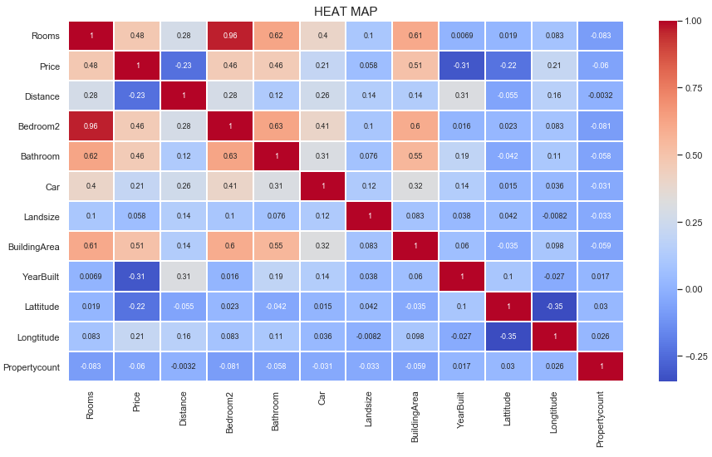
Correlation HEAT MAP – Understanding influence of factors on each other and Price
Rooms and Bedroom2 appear highly correlated 0.96 followed by Bathroom and Bedroom2 0.63
Rooms and Bathroom: 0.62, Building Area and Rooms:0.61, followed by Building Area and Bathroom: 0.55 and 0.51 for Building Area and Price.
Building Area and Bedroom2 not included in Machine Learning Model

Slide 10
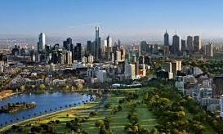
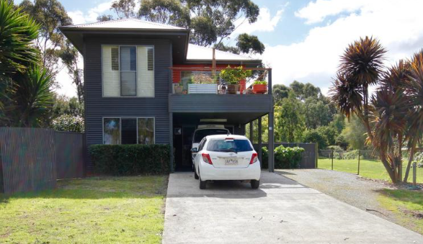
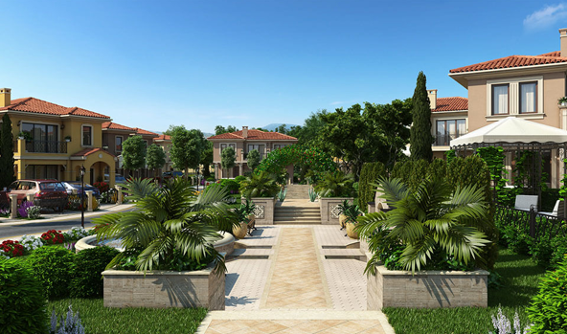
Analysis by Regions
To simplify analysis and visualizations city regions have been assigned abbreviated names as follows.
Northern Metropolitan: N Metro
Western Metropolitan: W Metro
Southern Metropolitan: S Metro
Eastern Metropolitan: E Metro
South-Eastern Metropolitan: SE Metro
Northern Victoria: N Vic
Eastern Victoria: E Vic
Western Victoria: W Vic

Slide 11
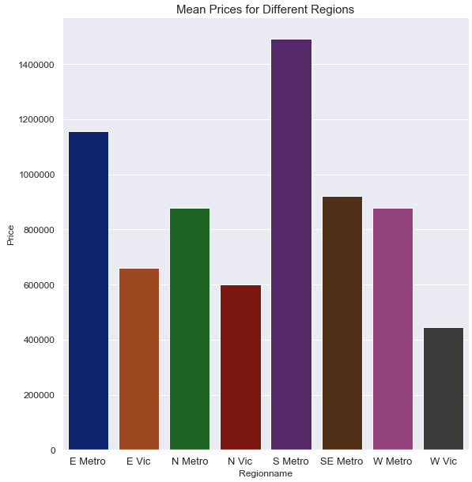
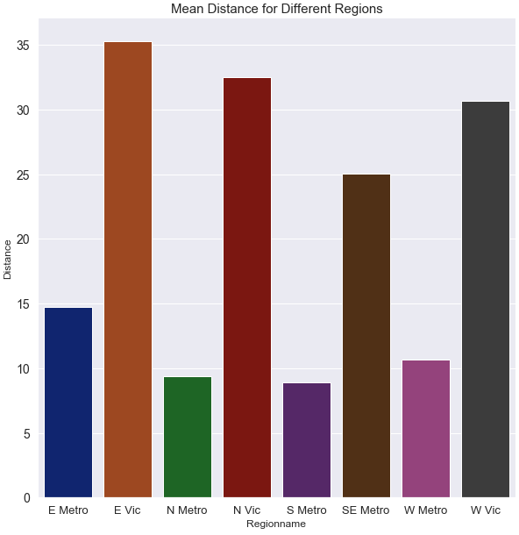
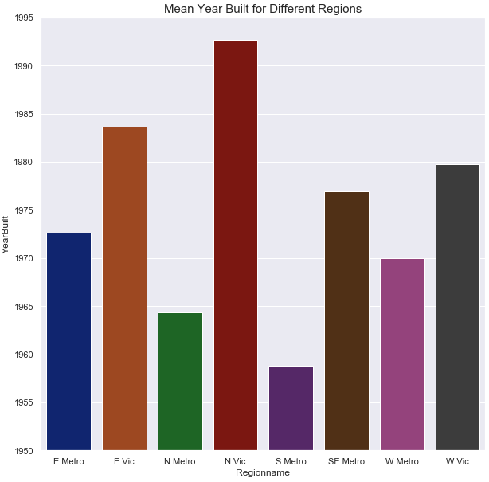
Mean Values – Analysis by Regions – I
The regions closest to CBD including N Metro, S Metro, E Metro appear to have a higher price with 50’s, 70’s and 90’s construction.
Where as regions with higher distance appear to have newer construction and lower price for example North Victoria.
Notes:
W Vic appears to be cheapest in price 3rd largest in distance, small land size, larger building area, more rooms, car spaces and less bathrooms.

Slide 12
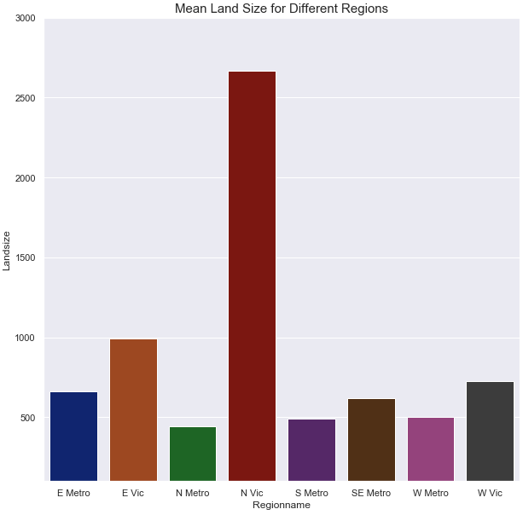
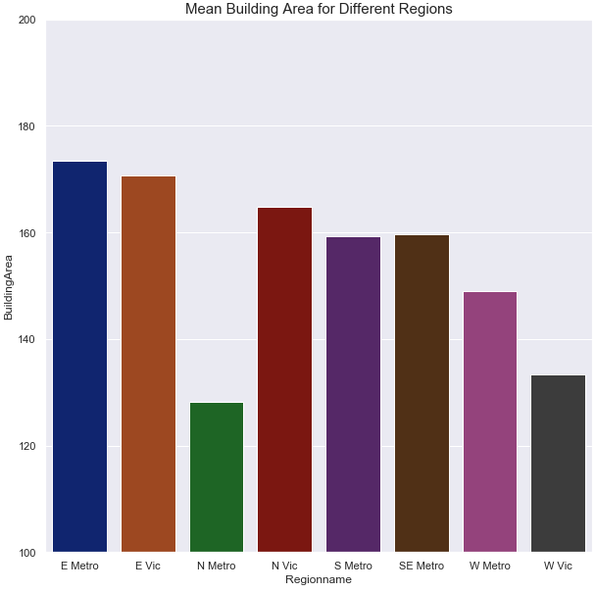
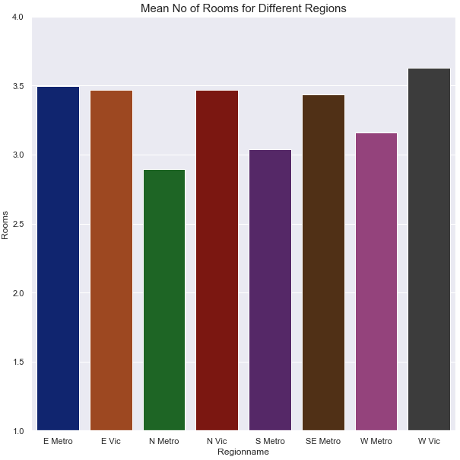
Mean Values – Analysis by Regions – II
Regions closer to the CBD appear to have less land size and building but higher no of rooms (Apartment buildings)
Where as regions such as North and East Victoria which are located at a distance have higher land size and building area with higher number of rooms

Slide 13
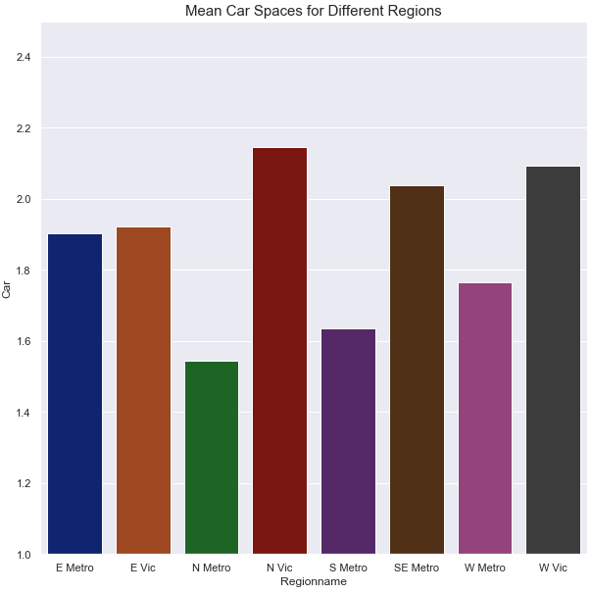
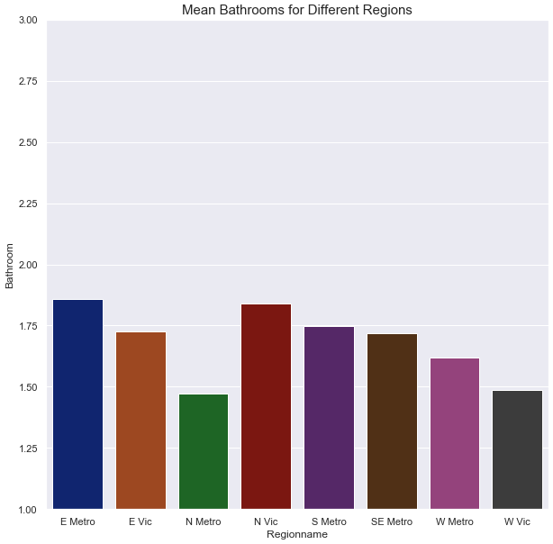
Mean Values – Analysis by Regions – III
Regions closer to CBD like North, South and West Metro are expensive with less land and building size and have fewer car spaces.
Whereas farther regions like North and West Victoria considering higher land and building size have more car spaces
No of Bathrooms is correlated with rooms 0.62. From previous analysis it can be inferred that for a property with three rooms there are 1.5 to two Bathrooms available.

Slide 14
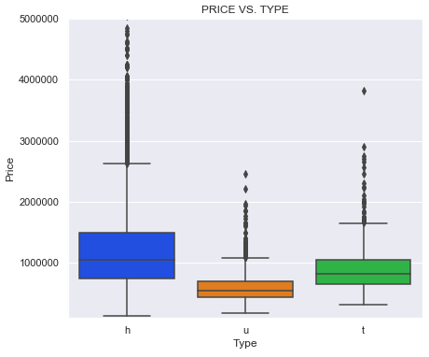
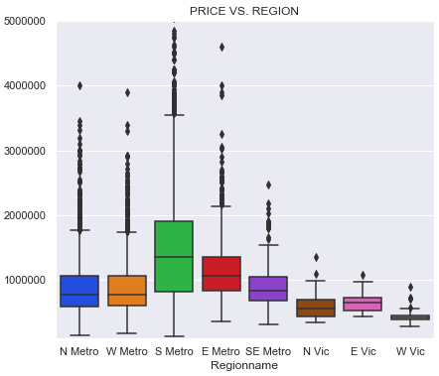
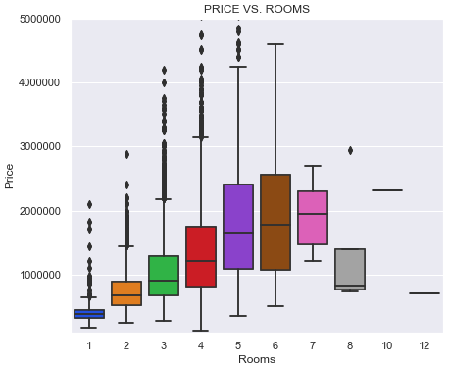
Price Analysis using Box Plots – I
The prices of homes appear to be higher followed by town homes and then units.
South Metro region closest to CBD appears to have the highest price followed by E and SE Metro regions.

Slide 15
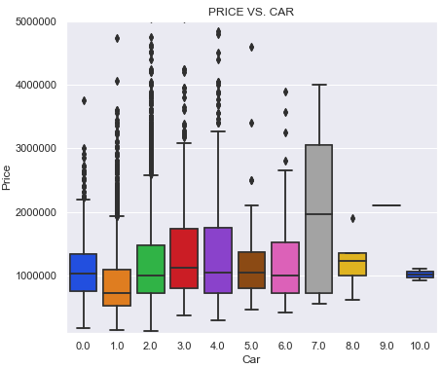
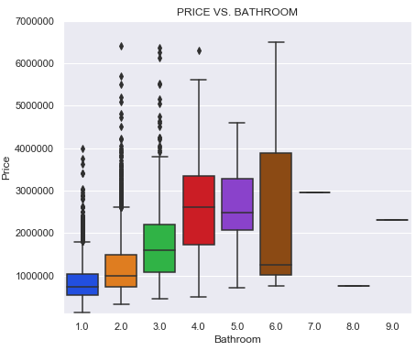
Price Analysis using Box Plots – II
Properties with higher no of car spaces and Bathrooms appear to be costly.
Whereas properties with 3 car spaces and 3 Bathrooms have median values of approximately 1 to 1.5 Million Dollars

Slide 16
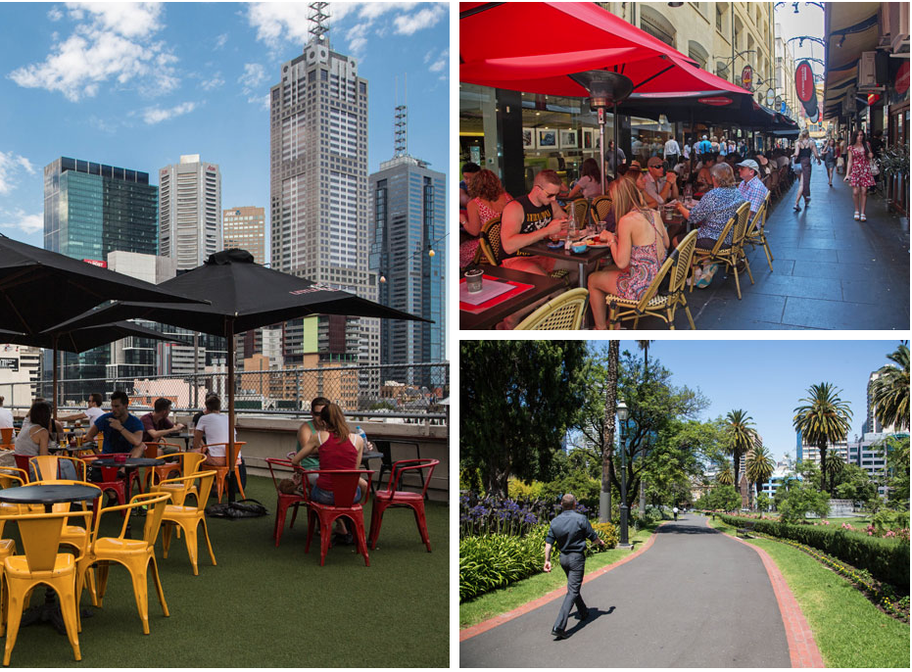
Problem Statement
As analyzed and discussed in exploratory analysis the home prices in Melbourne
depend upon several different factors.
The purpose of this project is to identify the following.
Discover important factors which drive prices in the Melbourne housing market.
Explore relationship between different factors and their relationship with price.
Analyze the most significant factors that impact housing prices
Prepare a Model based upon identified factors and accurately predict housing prices.
Compare Models for accuracy
Our Target or Dependent variable for this analysis will be Price.
Where as important features will be selected using a machine learning algorithm.

Slide 17

Machine Learning Models
For this project we will be using two different algorithms, Random Forest and Multiple Linear Regression in order to predict price of housing in Melbourne Australia.
Random forest is an ensemble learning method for classification and regression which builds multiple decision trees and merges them together to get a more accurate and stable prediction.
Multiple Linear Regression is used to explain the relationship between one continuous dependent variable and two or more independent variables.
In present scenario our dependent variable is Price whereas the multiple independent variables include distance, land size, building area, room etc.
Reason for choosing the models:
Random Forest – The dataset appears to have large no of variables. The algorithm will help us identify most important features.
No of original variables 21
No of extended variables 229
Multiple Linear Regression – The algorithm will tell how much does our dependent variable Price changes with an amount of change in the independent variables.

Slide 18
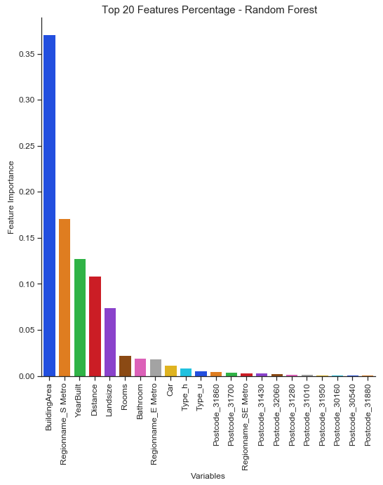
Model Parameters and Results
Model Parameters
Variables: 212
n_estimators: 250
max_depth: 15
Model results
Random Forest: 212 Variables
R² Train: 0.9662708569930585
R² Test: 0.8078177350596782
Mean Absolute Error: 171398.5471691893
Mean Squared Error: 94793273740.64745
Root Mean Squared Error: 307885.16323565744

Slide 19
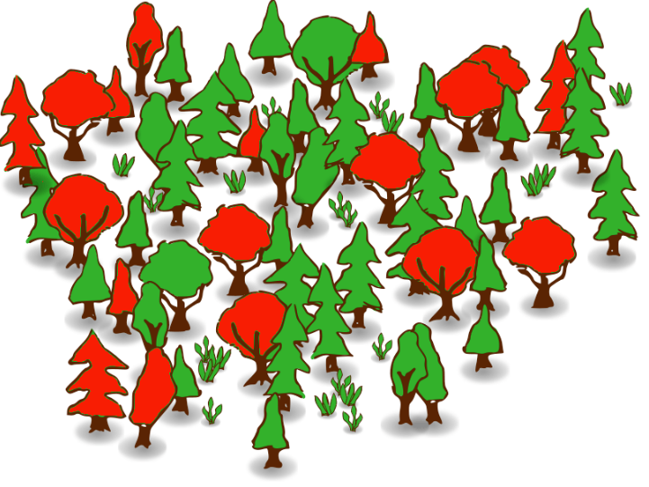
Random Forest Results with Max & Min Features
Random Forest: 212 Variables
Train Accuracy - R² : 0.9662708569930585
Test Accuracy - R² : 0.8078177350596782
Mean Absolute Error: 171398.5471691893
Mean Squared Error: 94793273740.64745
Root Mean Squared Error: 307885.16323565744
Rooms
Distance
Bathroom
Car
Landsize
BuildingArea
YearBuilt
Type_h
Type_u
Postcode_30160
Postcode_30540
Postcode_31010
Postcode_31280
Postcode_31430
Postcode_31700
Postcode_31860
Postcode_31880
Postcode_31950
Postcode_32060
Regionname_E Metro
Regionname_S Metro
Regionname_SE Metro
Random Forest: 22 Variables
Train Accuracy - R² : 0.9677837765735764
Test Accuracy - R² : 0.8047399497892608
Mean Absolute Error: 174401.20392445527
Mean Squared Error: 96311381260.84035
Root Mean Squared Error: 310340.7502421175

Slide 20
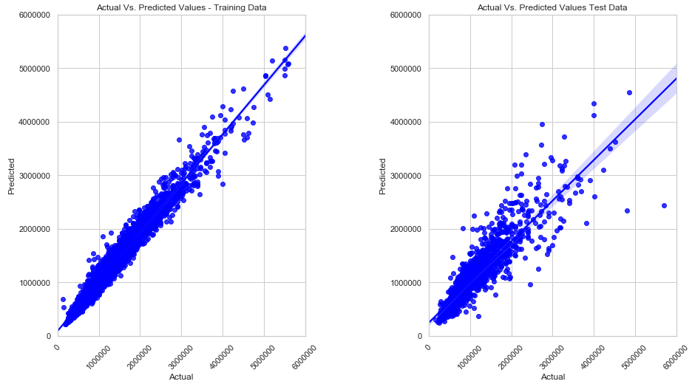
Random Forest Results Actual Vs. Predicted Values

Slide 21
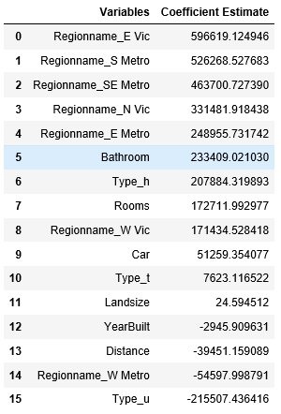
Linear Regression using Important Features
Linear Regression
Linear Regression: 16 Variables
Train Accuracy - R² : 0.6202410353433015
Test Accuracy - R² : 0.6068245415946455
Intercept: 5985283.630972797
Mean Absolute Error: 279719.61707274447
Mean Squared Error: 193932509164.13568
Root Mean Squared Error: 440377.6892215768
Rooms
Distance
Bathroom
Car
Landsize
YearBuilt
Type_h
Type_t
Type_u
Regionname_N Metro
Regionname_S Metro
Regionname_SE Metro
Regionname_W Metro
Regionname_N Vic
Regionname_W Vic
Regionname_E Vic

Slide 22
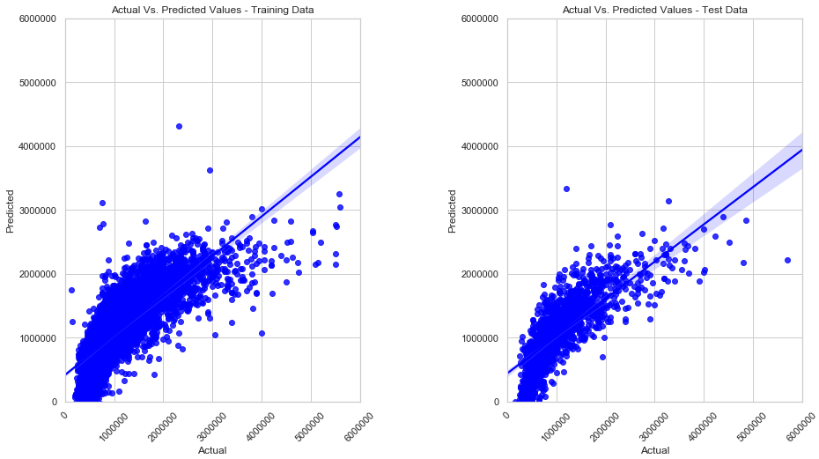
Linear Regression Actual Vs. Predicted Values

Slide 23
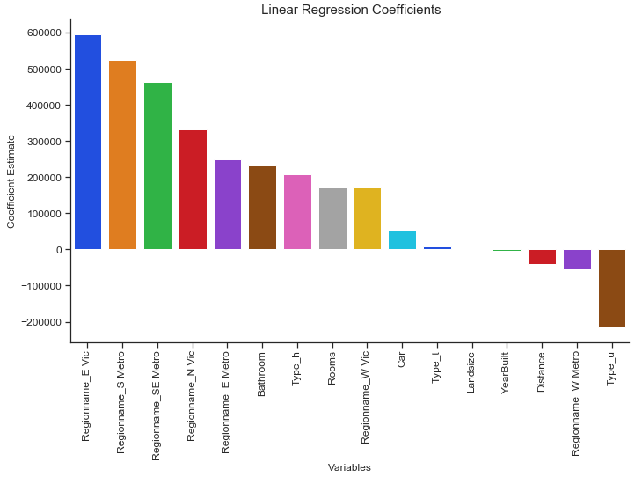
Multiple Linear Regression Actual Vs. Predicted Values

Slide 24
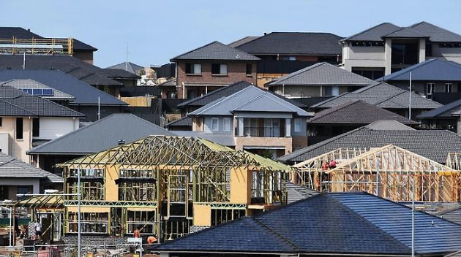
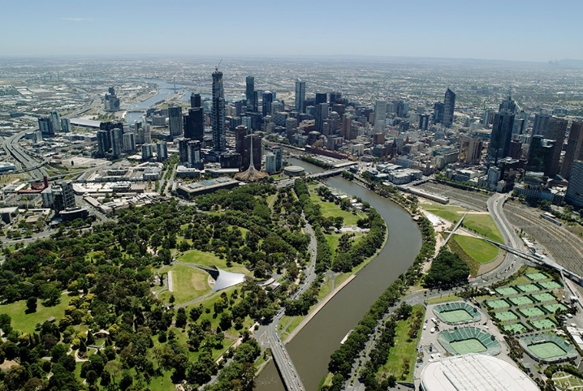
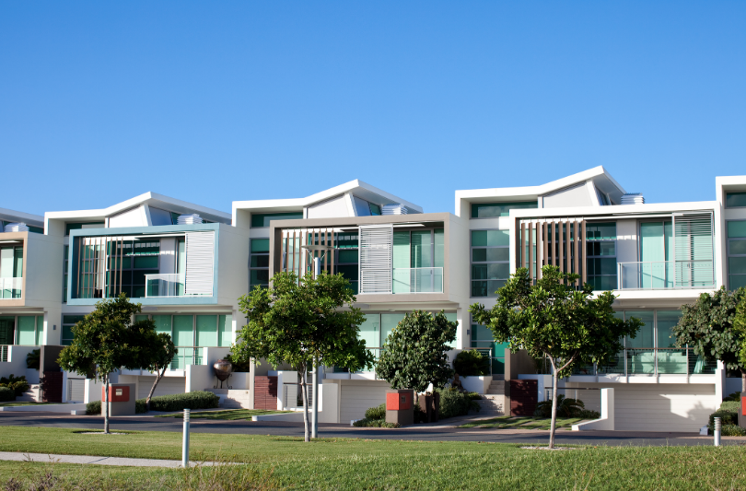
FINDINGS
Most important factors impacting price of housing in Melbourne are ranked as follows.
Rooms
Distance
Bathroom
Car
Landsize
BuildingArea
YearBuilt
Type_h
Type_u
Regionname_S Metro

Slide 25
CONCLUSION
E Vic, N Vic, W Vic appear to have cheaper price, larger distance, larger land size, more car space with 80’s and 90’s construction.
E Metro, N Metro, S Metro appears to have higher price, short distance, less land size, slightly less car space and 50’s, 60’s construction
SE Metro appears to be expensive located at a distance with 2 car spaces and mid 70’s construction.
W Vic appears cheapest in price, 3rd largest in distance, small land size, larger building area, more number of rooms, car spaces and less bathrooms.
The supervised learning model appears to have high variance and low bias.

